Slide 1
Windows 10 Module 1
Getting Started with Windows 10

Slide 2
Module Objectives
Start Windows 10
Navigate the desktop and Start menu
Point, click, and drag
Start an app
Work with a window
Manage multiple windows
Use buttons, menus, and dialog boxes
Get help
Exit Windows 10

Slide 3
Start Windows 10 (Slide 1 of 3)
Windows 10 is an operating system, which is a program that lets you run your computer
A program is a set of instructions

Slide 4
Start Windows 10 (Slide 2 of 3)
Microsoft account is a reserved area where each user keeps his or her files
Must sign in, also called logging in, using account information and a password
  Process keeps your computer information secure
  Passwords are case-sensitive; booklet43+ is not the same as Booklet43+

Slide 5
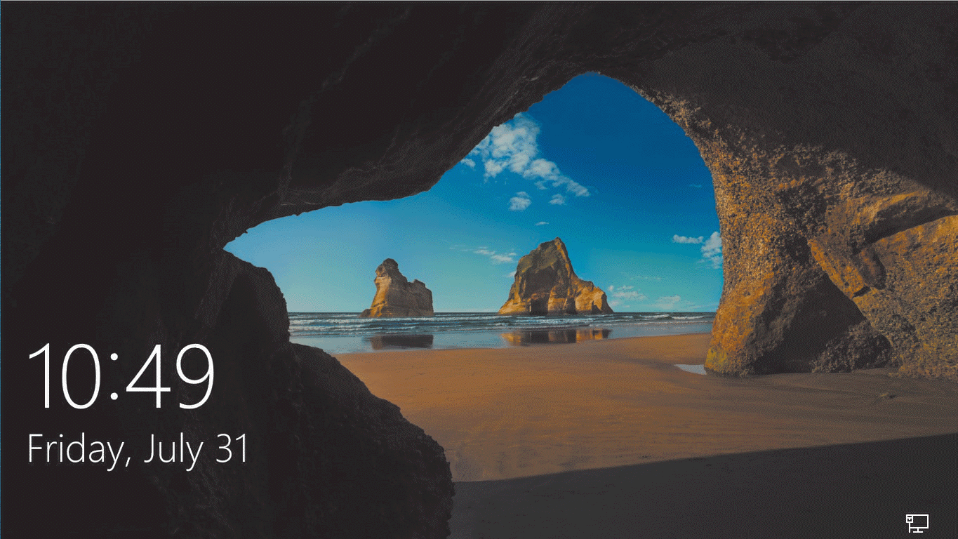
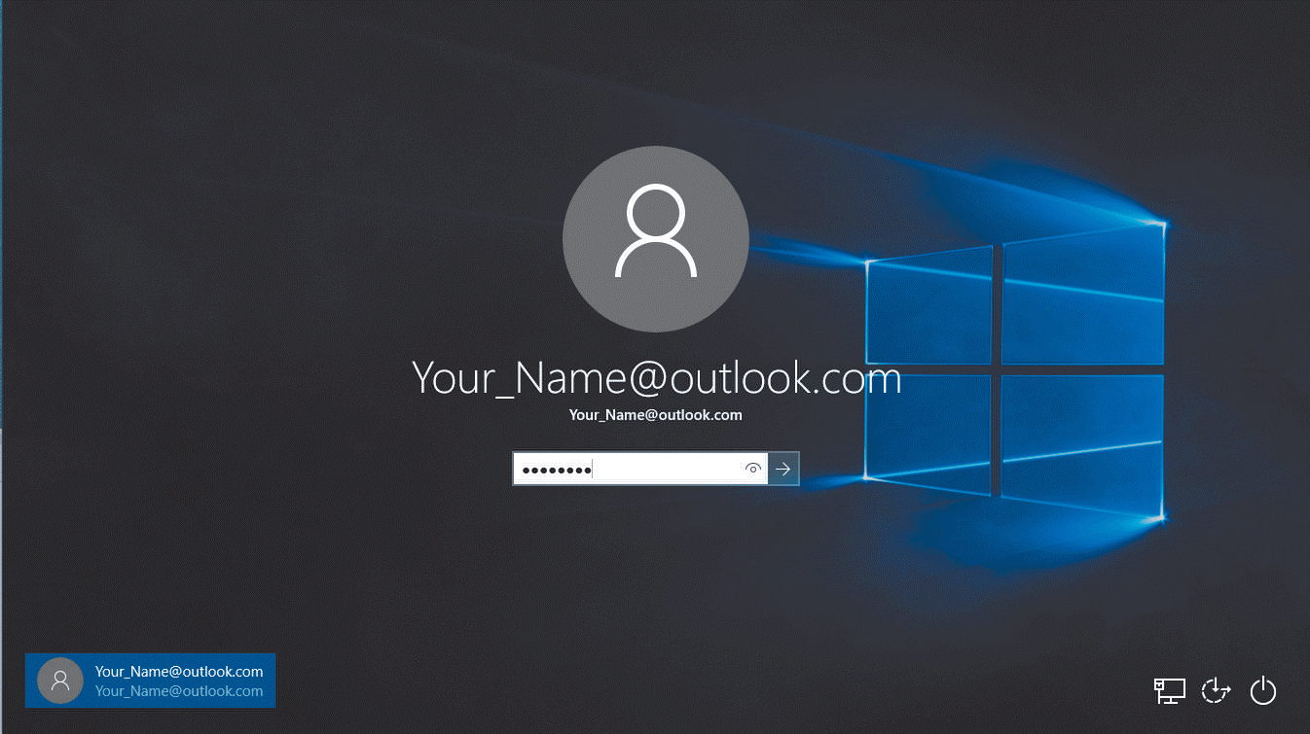
Start Windows 10 (Slide 3 of 3)

Slide 6
Navigate the Desktop and Start Menu (Slide 1 of 3)
Windows 10 desktop appears when you start your computer
  Electronic work area to organize and manage information
User interface (UI) are controls that let you interact with Windows 10
Desktop can include
  Icons, such as Recycle Bin
  Files (collection of stored information)
  Folders (containers to organize files)

Slide 7
Navigate the Desktop and Start Menu (Slide 2 of 3)
To display the Start menu, click the Start button
Start menu shows:
  List of frequently used programs
  Shaded rectangles called tiles; tiles represent application programs or apps

Slide 8
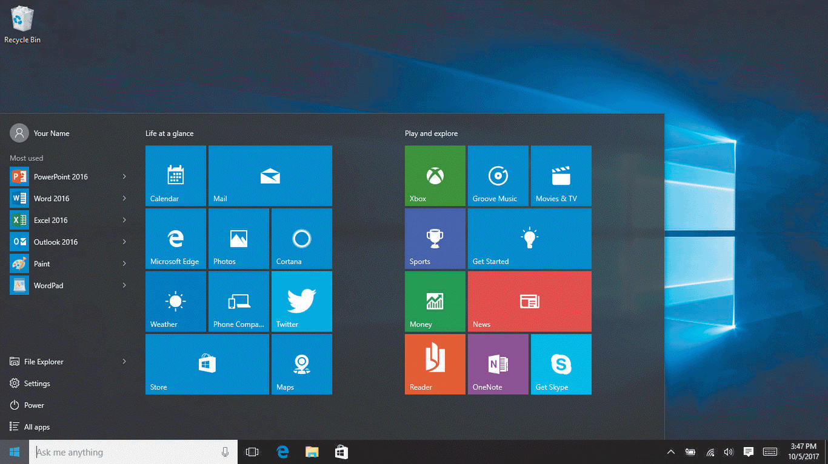
Navigate the Desktop and Start Menu (Slide 3 of 3)

Slide 9
Point, Click, and Drag (Slide 1 of 2)
A pointing device controls the movement of the pointer
  Examples are mouse, trackball, graphics tablet, touchpad
A pointer is a small arrow or other symbol that moves on the screen

Slide 10
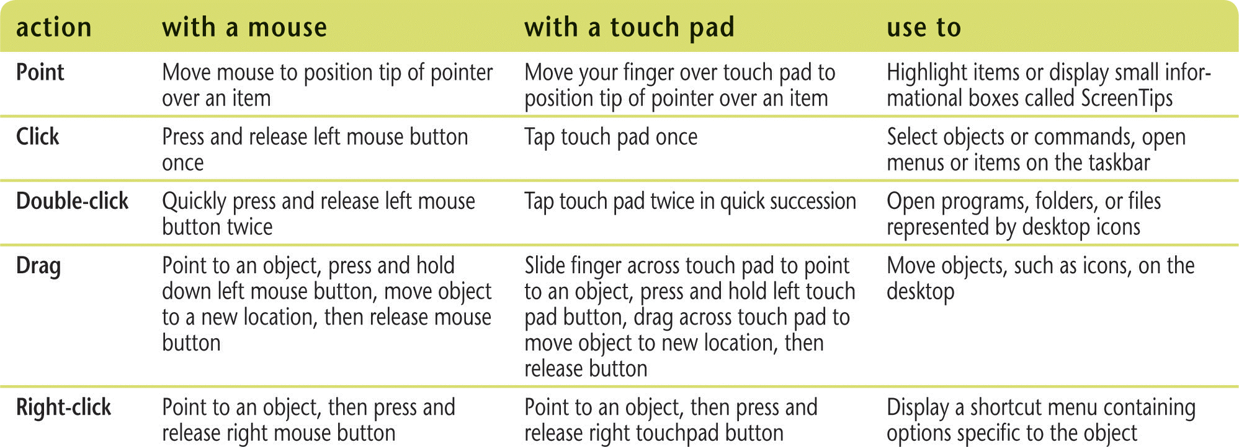
Point, Click, and Drag (Slide 2 of 2)

Slide 11
Start an App (Slide 1 of 3)
Windows apps are small programs that can run on desktops, laptops, tablets, and phones
  Photos app
  OneDrive app
Desktop apps are fully-featured programs
  Microsoft Word
Windows accessories are already installed in Windows 10
  Paint
  Notepad

Slide 12
Start an App (Slide 2 of 3)
Click Start button then click tile
  Weather
Click Start button then type app name
  Paint

Slide 13
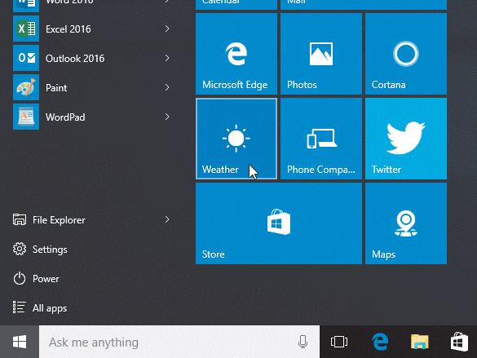
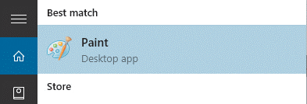
Start an App (Slide 3 of 3)

Slide 14
Work with a Window (Slide 1 of 4)
When you start an app, its window, a frame displaying app’s tools, opens
All windows in the Windows 8 operating system have similar elements
The title bar at the top of the open window contains the name of the document and the app

Slide 15
Work with a Window (Slide 2 of 4)
Window control buttons located on right side of title bar
  Minimize button – Hides window, making it a button on taskbar
  Maximize button – Enlarges window to fill entire screen
  Restore Down button – Reduces window to previous size and position (available after maximizing a window)
  Close button – closes a window
Scroll bars
  Necessary in some windows when you have additional items to display

Slide 16
Work with a Window (Slide 3 of 4)
Ribbon
  Located just below title bar
  Contains tabs which are divided into groups
  Can include menus and toolbars
Quick Access toolbar
  Located on the left side of title bar
  Can perform common tasks with one click

Slide 17
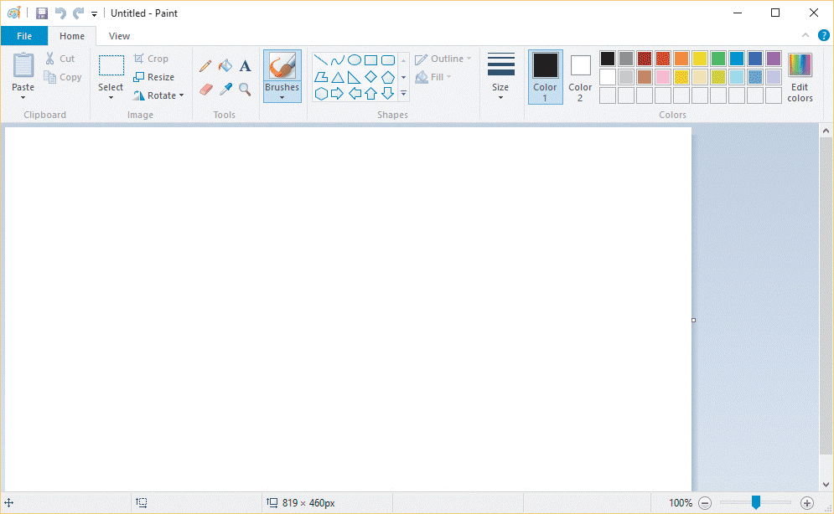
Work with a window (Slide 4 of 4)
Typical app window elements

Slide 18
Manage Multiple Windows (Slide 1 of 3)
Windows 10 lets you work with more than one app at a time
If you open two or more apps, a window opens for each one
The window in front is called the active window
Any window behind the active window is called an inactive window
To resize a window, drag a window’s edge, called its border

Slide 19
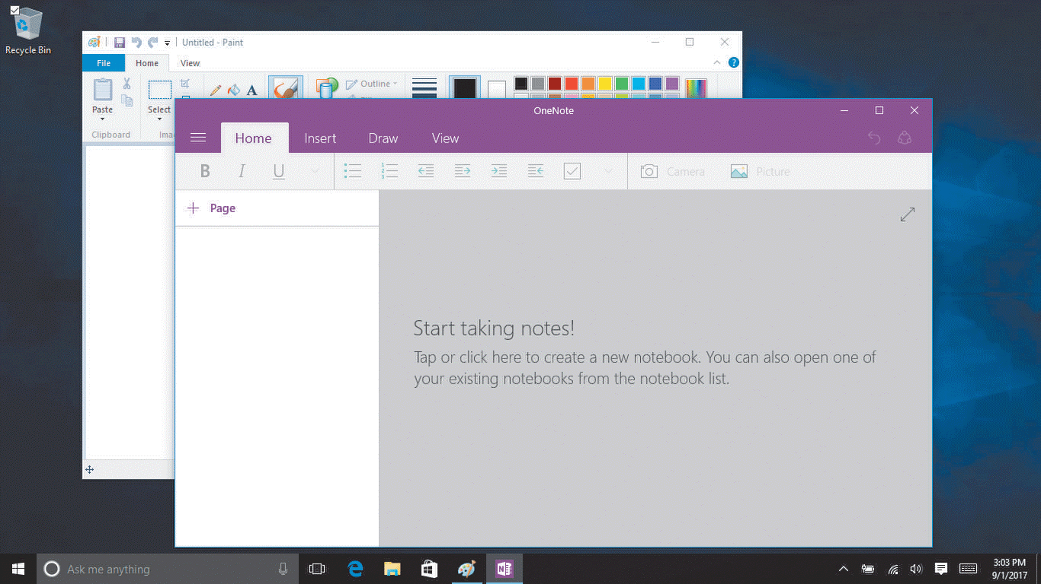
Manage Multiple Windows (Slide 2 of 3)
OneNote window in front of Paint window

Slide 20
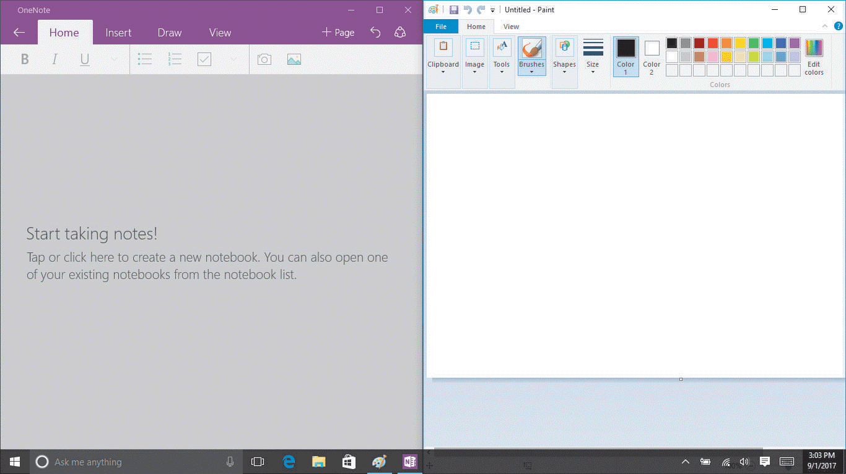
Manage Multiple Windows (Slide 3 of 3)
OneNote and Paint windows snapped to each side of screen

Slide 21
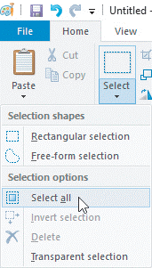
Using Buttons, Menus, and Dialog Boxes (Slide 1 of 3)
Buttons let you issue instructions
Some reveal menus

Slide 22
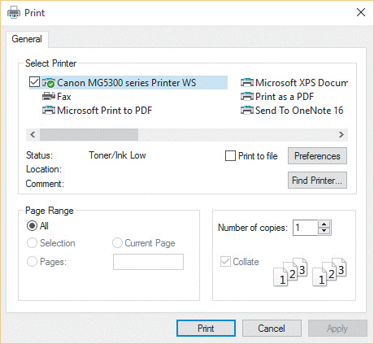
Use Buttons, Menus, and Dialog Boxes (Slide 2 of 3)
Some buttons open a dialog box, a window with controls that lets you tell Windows what you want

Slide 23
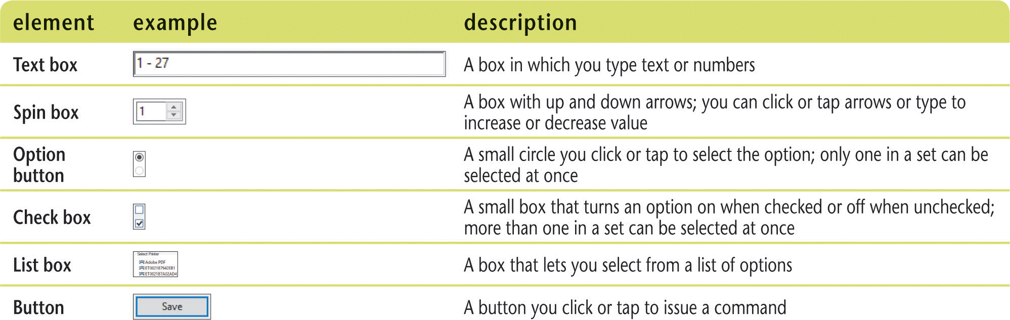
Use Buttons, Menus, and Dialog Boxes (Slide 3 of 3)
Common dialog box controls

Slide 24
Get Help
Windows 10 Getting Started app
  Click Get Started tile
Cortana
  Digital personal assistant that comes with Windows 10
  Accepts voice or typed commands

Slide 25
Exit Windows 10 (Slide 1 of 2)
When finished working
  Close any open files
  Exit any open apps
  Close any open windows
  Exit (shut down) Windows 10
Failure to shut down correctly can result in lost data or damage to your computer

Slide 26
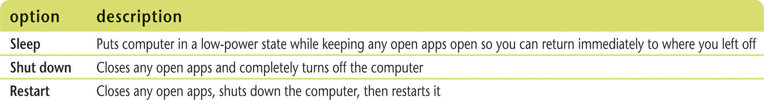
Exit Windows 10 (Slide 1 of 2)
Power Options

